Slide 1
Feature selection using Chi-Squared Test of Independence
Prof.Aruna Malapati

Slide 2
Learning Objectives
Explain and formulate Chi-Squared test of independent between two variables
Apply Chi-Squared test of independence for categorical variables

Slide 3

Hypothesis Testing
Hypothesis is a premise or claim that we want to investigate.
Test whether the two random variables (categorical) are independent or not.
Test Statistic
Chi-Squared Test
T-Test
ANNOVA-Test
Test Statistic
Notes:
We will assume that H0 is always true unless the evidence portraits something else.in which case we will reject the Null hypothesis and accept Ha
We are going to test if H0 is true
Mathematically H0 and HA are mathematically opposite of each other
Chi-square test of independence allow us to see whether or not two categorical variables are related or if they are not. If the variables had no effect on each other, then we would expect the distributions across the rows or the columns to be about the same. And the expected count for each cell is the product of the row totals and column totals, divided by the grand total.

Slide 4
Example
A group of customers were classified in terms of personality (introvert, extrovert or normal) and in terms of color preference (red, yellow or green) with the purpose of seeing whether there is an association (relationship) between personality and color preference.
Data was collected from 400 customers and presented in the 3 (rows) x 3 (cols) contingency table below:
(Observed counts) | Colors
Personality | Red | Yellow | Green | Totals
Introvert personality | 11 | 5 | 1 | 17
Extrovert personality | 8 | 6 | 8 | 22
Normal | 3 | 10 | 12 | 25
Total | 22 | 21 | 21 | 64

Slide 5
Five-step approach for Chi-Squared test of independence
Step 1. Set up hypotheses and determine level of significance.
Null hypothesis(H0): Color preference is independent of personality.
Alternative hypothesis(H_{A}): Color preference is dependent on personality
α=0.05
Notes:
We will assume that H₀ is always true unless the evidence portraits something else in which case we will reject the Null hypothesis and accept H_{A}
We are going to test if H₀ is true
Mathematically H₀ and H_{A} are mathematically opposite of each other
Chi-square test of independence allow us to see whether or not two categorical variables are related or if they are not. If the variables had no effect on each other, then we would expect the distributions across the rows or the columns to be about the same. And the expected count for each cell is the product of the row totals and column totals, divided by the grand total

Slide 6
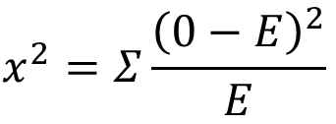

Five-step approach for Chi-Squared test of independence (contd..)
Step 2. Compute the expected frequency (under the null hypothesis) in each cell using E = (Row Total * Column Total)/N
Step 3:Select the test statistic
$x^{2}$ =$\frac{{\left(11−5.8\right)}^{2}}{\overline{5.8}}$ + $\frac{{\left(5−5.6\right)}^{2}}{5.6}$+ $\frac{{\left(1−5.6\right)}^{2}}{5.6}$+ ….. + $\frac{{\left(12−8.2\right)}^{2}}{8.2}$ = 14.5
(Expected counts) | Colors
Personality | Red | Yellow | Green | Totals
Introvert personality | 5.8 | 5.6 | 5.6 | 17
Extrovert personality | 7.6 | 7.2 | 7.2 | 22
Normal | 8.6 | 8.2 | 8.2 | 25
Total | 22 | 21 | 21 | 64

Slide 7
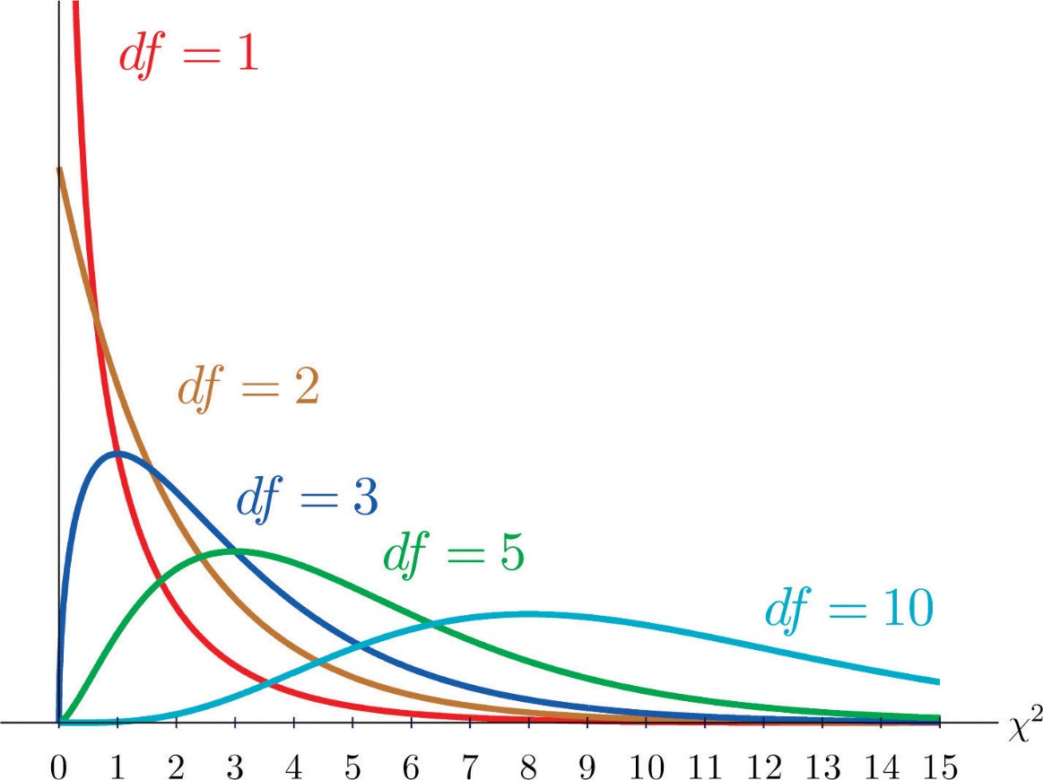
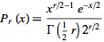

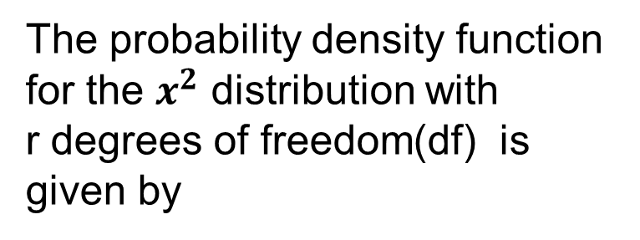
Chi-Squared distribution
The probability density function
for the $x^{2}$ distribution with
r degrees of freedom(df) is given by
Less skewed as df increases
Wider
Higher values for $x^{2}$
Always positive
Notes:
Here you see the distribution with 1,2,3,5 and 10.
The distribution is always positive if you think about it which makes sense since the formula has a square

Slide 8
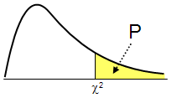
Significance of P value
=14.5
Notes:
So the P value is the area to the right of $x^{2}$ value using this we draw conclusions

Slide 9
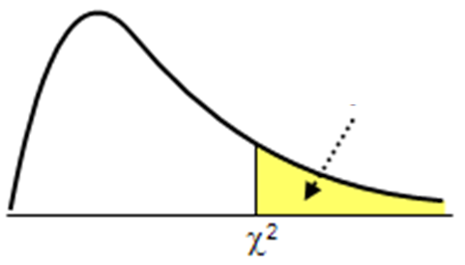
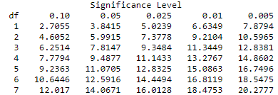

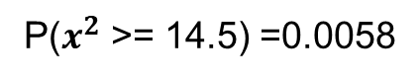
Five-step approach for Chi-Squared test of independence (Contd..)
7.81
Step 4: Use a probability table to find P-Value associated with $x^{2}$ value for with degrees of freedom df = (r − 1) (c − 1), r is the number of categories in one variable and c is the number of categories in the other.
Step 5: Make a conclusion using P-value
P($x^{2}$ >= 14.5) =0.0058
P value < 0.05
Reject the Null hypothesis (H₀)

Slide 10
Thank You!
In our next session:Feature selection using Information Theoretic Measures

